Slide 1
Noun Phrase Extraction
A Description of Current Techniques

Slide 2
What is a noun phrase?
A phrase whose head is a noun or pronoun optionally accompanied by a set of modifiers
  Determiners:
    Articles: a, an, the
    Demonstratives: this, that, those
    Numerals: one, two, three
    Possessives: my, their, whose
    Quantifiers: some, many
  Adjectives: the red ball
  Relative clauses: the books that I bought yesterday
  Prepositional phrases: the man with the black hat

Slide 3
Is that really what we want?
POS tagging already identifies pronouns and nouns by themselves
The man whose red hat I borrowed yesterday in the street that is next to my house lives next door.
  [The man [whose red hat [I borrowed yesterday]_{RC} ]_{RC} [in the street]_{PP} [that is next to my house]_{RC} ]_{NP} lives [next door]_{NP}.
Base Noun Phrases
  [The man]_{NP} whose [red hat]_{NP} I borrowed [yesterday ]_{NP} in [the street]_{NP} that is next to [my house]_{NP} lives [next door]_{NP}.

Slide 4
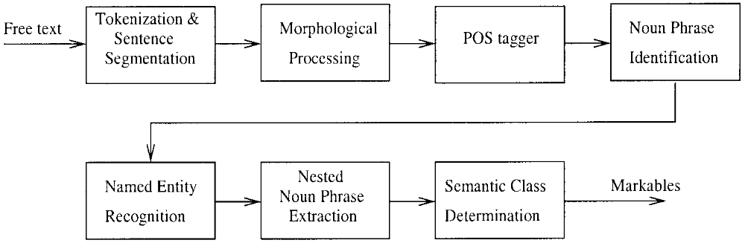
How Prevalent is this Problem?
Established by Steven Abney in 1991 as a core step in Natural Language Processing
Quite explored

Slide 5
What were the successful early solutions?
Simple Rule-based/ Finite State Automata
  Both of these rely on the aptitude of the linguist formulating the rule set.

Slide 6
Simple Rule-based/ Finite State Automata
A list of grammar rules and relationships are established. For example:
  If I have an article preceding a noun, that article marks the beginning of a noun phrase.
  I cannot have a noun phrase beginning after an article
The simplest method

Slide 7
FSA simple NPE example
noun/ pronoun/ determiner
determiner/adjective
noun/ pronoun
S₀
S₁
NP
adjective
Relative clause/
Prepositional phrase/
noun

Slide 8
Simple rule NPE example
“Contextualization” and “lexicalization”
  Ratio between the number of occurrences of a POS tag in a chunk and the number of occurrences of this POS tag in the training corpora

Slide 9
Parsing FSA’s, grammars, regular expressions: LR(k) Parsing
The L means we do Left to right scan of input tokens
The R means we are guided by Rightmost derivations
The k means we will look at the next k tokens to help us make decisions about handles
We shift input tokens onto a stack and then reduce that stack by replacing RHS handles with LHS non-terminals

Slide 10
An Expression Grammar
E -> E + T
E -> E - T
E -> T
T -> T * F
T -> T / F
T -> F
F -> (E)
F -> i

Slide 11
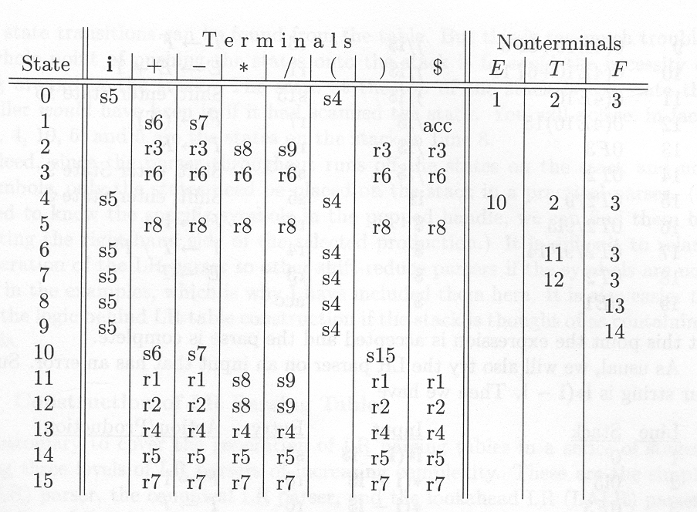
LR Table for Exp Grammar

Slide 12
An LR(1) NPE Example
Stack Input Action
[] N V N SH N
[N] V N RE 3.) NP → N
[NP] V N SH V
[NP V] N SH N
[NP V N] RE 3.) NP → N
[NP V NP] RE 4.) VP → V NP
[NP VP] RE 1.) S → NP VP
[S] Accept!
S → NP VP
NP → Det N
NP → N
VP → V NP
(Abney, 1991)

Slide 13
Why isn’t this enough?
Unanticipated rules
Difficulty finding non-recursive, base NP’s
Structural ambiguity

Slide 14
Structural Ambiguity
  “I saw the man with the telescope.”
S
S
NP
VP
NP
VP
I
V
NP
I
VP
NP
saw
V
DET
N
PP
DET
N
PP
the
man
saw
the
man
PRP
DET
N
PRP
DET
N
with
the
telescope
with
the
telescope

Slide 15
What are the more current solutions?
Machine Learning
  Transformation-based Learning
  Memory-based Learning
  Maximum Entropy Model
  Hidden Markov Model
  Conditional Random Field
  Support Vector Machines

Slide 16
Machine Learning means TRAINING!
Corpus: a large, structured set of texts
  Establish usage statistics
  Learn linguistics rules
The Brown Corpus
  American English, roughly 1 million words
  Tagged with the parts of speech
  http://www.edict.com.hk/concordance/WWWConcappE.htm

Slide 17
Transformation-based Machine Learning
An ‘error-driven’ approach for learning an
ordered set of rules
1. Generate all rules that correct at least one error.
2. For each rule:
(a) Apply to a copy of the most recent state of the training set.
(b) Score the result using the objective function.
3. Select the rule with the best score.
4. Update the training set by applying the selected
rule.
5. Stop if the score is smaller than some pre-set
threshold T; otherwise repeat from step 1.

Slide 18
Transformation-based NPE example
Input:
  “Whitney_{NN} currently_{ADV} has_{VB} the_{DT} right_{ADJ} idea_{NN}.”
Expected output:
  “[NP Whitney] [ADV currently] [VB has] [NP the right idea].”
Rules generated (all not shown):
From To If
NN NP always
ADJ NP the previous word was ART
DT NP the next word is an ADJ
DT NP the previous word was VB

Slide 19
Memory-based Machine Learning
Classify data according to similarities to other data observed earlier
“Nearest neighbor”
Learning
  Store all “rules” in memory
Classification:
  Given new test instance X,
    Compare it to all memory instances
    Compute a distance between X and memory instance Y
  Update the top k of closest instances (nearest neighbors)
  When done, take the majority class of the k nearest neighbors as the class of X
Daelemans, 2005

Slide 20
Memory-based Machine Learning Continued
Distance…?
The Overlapping Function: Count the number of mismatching features
The Modified Value Distance Metric (MVDM) Function: estimate a numeric distance between two “rules”
  The distance between two N-dimensional vectors A, B with discrete (for example symbolic) elements, in a K class problem, is computed using conditional probabilities:
  d(A,B) = Σ_{j..n} Σ_{i..k} (P(C_{i} I A_{j}) - P(C_{i} | P_{j}))
  where p(C_{i}lA_{j}) is estimated by calculating the number N_{i}(A_{j}) of times feature A_{j} occurred in vectors belonging to class C_{i}, and dividing it by the number of times feature A_{j} occurred for any class
Dusch, 1998

Slide 21
Memory-based NPE example
Suppose we have the following candidate sequence:
  DT ADJ ADJ NN NN
    “The beautiful, intelligent summer intern”
In our rule set we have:
  DT ADJ ADJ NN NNP
  DT ADJ NN NN

Slide 22
Maximum Entropy
The least biased probability distribution that encodes information maximizes the information entropy, that is, the measure of uncertainty associated with a random variable.
Consider that we have m unique propositions
  The most informative distribution is one in which we know one of the propositions is true – information entropy is 0
  The least informative distribution is one in which there is no reason to favor any one proposition over another – information entropy is log m

Slide 23
Maximum Entropy applied to NPE
Let’s consider several French translations of the English word “in”
p(dans) + p(en) + p(á) + p(au cours de) + p(pendant) = 1
Now suppose that we find that either dans or en is chosen 30% of the time. We must add that constraint to the model and choose the most uniform distribution
  p(dans) = 3/20
  p(en) = 3/20
  p(á) = 7/30
  p(au cours de) = 7/30
  p(pendant) = 7/30
What if we now find that either dans or á is used half of the time?
p(dans) + p(en) = .3
p(dans) + p(á) = .5
Now what is the most “uniform” distribution?
Berger, 1996

Slide 24
Hidden Markov Model
In a statistical model of a system possessing the Markov property…
  There are a discrete number of possible states
  The probability distribution of future states depends only on the present state and is independent of past states
These states are not directly observable in a hidden Markov model.
The goal is to determine the hidden properties from the observable ones.

Slide 25
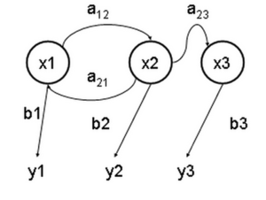
Hidden Markov Model
a: transition probabilities
x: hidden states
y: observable states
b: output probabilities

Slide 26
HMM Example
states = ('Rainy', 'Sunny')
observations = ('walk', 'shop', 'clean')
start_probability = {'Rainy': 0.6, 'Sunny': 0.4}
transition_probability = {
'Rainy' : {'Rainy': 0.7, 'Sunny': 0.3},
'Sunny' : {'Rainy': 0.4, 'Sunny': 0.6}, }
emission_probability = {
'Rainy' : {'walk': 0.1, 'shop': 0.4, 'clean': 0.5},
'Sunny' : {'walk': 0.6, 'shop': 0.3, 'clean': 0.1}, }
In this case, the weather possesses the Markov property

Slide 27
HMM as applied to NPE
In the case of noun phrase extraction, the hidden property is the unknown grammar “rule”
Our observations are formed by our training data
Contextual probabilities represent the transition states
  that is, given our previous two transitions, what is the likelihood of continuing, ending, or beginning a noun phrase/ P(o_{i}|o_{j-1},o_{j-2})
Output probabilities
  Given our current state transition, what is the likelihood of our current word being part of, beginning, or ending a noun phrase/ P(i_{j}|o_{j})
Max_{O1…OT}( π_{j:1…T} P(o_{i}|o_{j-1},o_{j-2}) · P(i_{j}|o_{j}) )

Slide 28
The Viterbi Algorithm
Now that we’ve constructed this probabilistic representation, we need to traverse it
Finds the most likely sequence of states

Slide 29
Viterbi Algorithm
Whitney gave a painfully long presentation.
B
I
O

Slide 30
Conditional Random Fields
An undirected graphical model in which each vertex represents a random variable whose distribution is to be inferred, and each edge represents a dependency between two random variables. In a CRF, the distribution of each discrete random variable Y in the graph is conditioned on an input sequence X
Y_{i} could be B,I,O in the NPE case
…
y₁
y₂
y₃
y₄
y_{n-1}
y_{n}
x₁, …, x_{n-1,} x_{n}

Slide 31
Conditional Random Fields
The primary advantage of CRF’s over hidden Markov models is their conditional nature, resulting in the relaxation of the independence assumptions required by HMM’s
The transition probabilities of the HMM have been transformed into feature functions that are conditional upon the input sequence

Slide 32
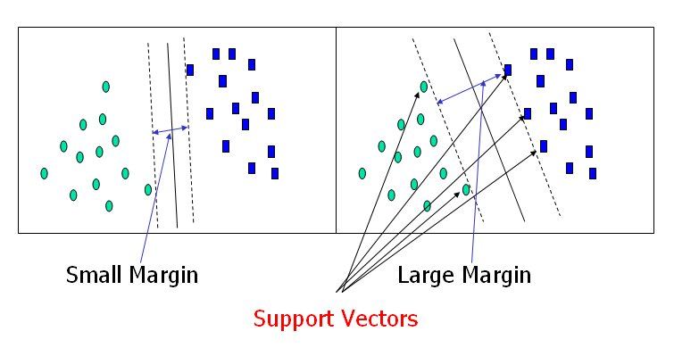
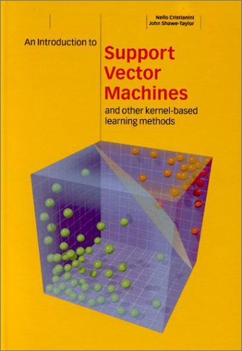
Support Vector Machines
We wish to graph an number of data points of dimension p and separate those points with a p-1 dimensional hyperplane that guarantees the maximum distance between the two classes of points – this ensures the most generalization
These data points represent pattern samples whose dimension is dependent upon the number of features used to describe them
http://www.csie.ntu.edu.tw/~cjlin/libsvm/#GUI

Slide 33
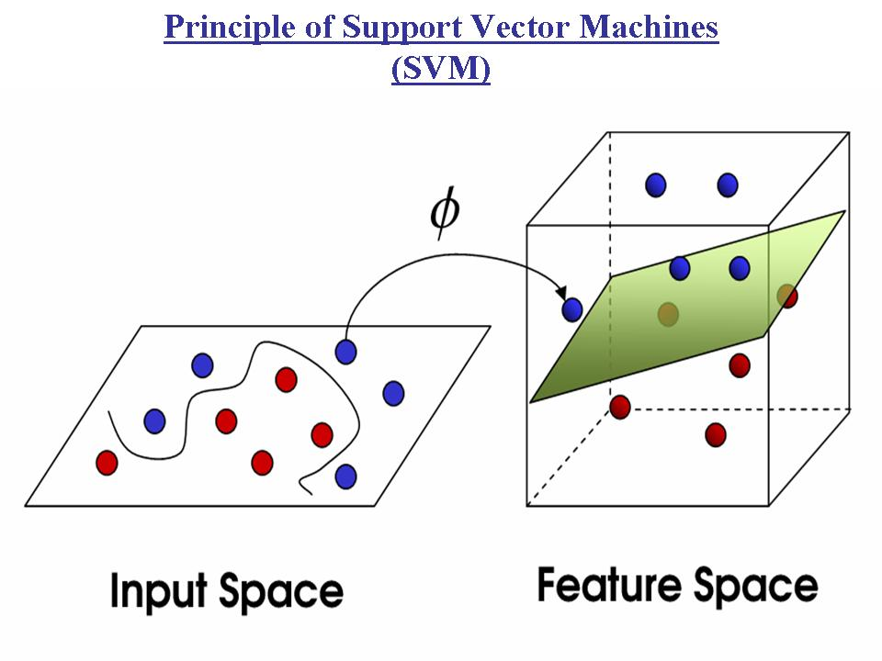
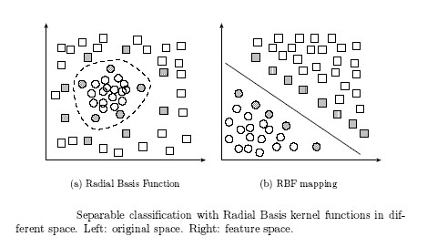
What if our points are separated by a nonlinear barrier?
The Kernel function (Φ): maps points from 2d to 3d space
  The Radial Basis Function is the best function that we have for this right now

Slide 34
SVM’s applied to NPE
Normally, SVM’s are binary classifiers
For NPE we generally want to know about (at least) three classes:
  B: a token is at the beginning of a chunk
  I: a token is inside a chunk
  O: a token is outside a chunk
We can consider one class vs. all other classes for all possible combinations
We could do a pairwise classification
  If we have k classes, we build k · (k-1)/2 classifiers

Slide 35
Performance Metrics Used
Precision = number of correct responses
number of responses
Recall = number of correct responses
number correct in key
F-measure = (β² + 1) RP
(β²R) + P
Where β² represents the relative weight of recall to precision (typically 1)
(Bikel, 1998)

Slide 36
Primary Work | Method | Implementation | Evaluation Data | Performance (F-measure) | Pros | Cons
Dejean | Simple rule-based | “ALLiS” Uses XML input Not available | CONLL 2000 task | 92.09 | Extremely simple, quick; doesn’t require a training corpus | Not very robust, difficult to improve upon; extremely difficult to generate rules
Ramshaw, Marcus | Transformation Based Learning | C++, Perl Available! | Penn Treebank | 92.03 - 93 | … | Extremely dependent upon training set and its “completeness” – how many different ways the NP are formed; requires a fair amount of memory
Tjong Kim Sang | Memory-Based Learning | “TiMBL” Python Available! | Penn Treebank, CONLL 2000 task | 93.34, 92.5 | Highly suited to the NLP task | Has no ability to intelligently weight “important” features; also it cannot identify feature dependency – both of these problems result in a loss of accuracy
Koeling | Maximum Entropy | Not available | CONLL 2000 task | 91.97 | First statistical approach, higher accuracy | Always makes the best local decision without much regard at all for position
Molina, Pla | Hidden Markov Model | Not available | CONLL 2000 task | 92.19 | Takes position into account | Make conditional independence assumptions which ignore special input features such as capitalization, suffixes, surrounding words
Sha, Pereira | Conditional Random Fields | Java Is Available… sort of CRF++ in C++ by Kudo also IS AVAILABLE! | Penn Treebank, CONLL 2000 task | 94.38 (“no significant difference”) | Can handle millions of features, handles both position and dependencies | “Over fitting”
Kudo, Matsumoto | Support Vector Machines | C++, Perl, Python Available! | Penn Treebank, CONLL 2000 task | 94.22, 93.91 | Minimizes error resulting in higher accuracy/ handles tons of features | Doesn’t really take position into account

